Slide 1
CNN Architectures: LeNet, AlexNet and VGGNet
Dr Deepayan Bhowmik

Slide 2

Recommended reading
Chapter 6, Chapter 7
Dive into Deep Learning
https://d2l.ai/
Some slides are adopted from M. M. Khapra, IIT Madras

Slide 3
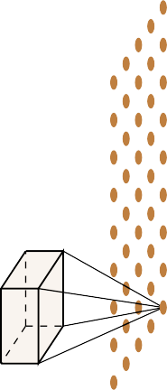
Recap, CNN notations and formulation
Convolution operator and filtering across various colour channels.
So far we have not said anything explicit about the dimensions of the
Inputs
Filters
Outputs
and the relations between them
We will see how they are related but before that we will define a few quantities
RGB
OUTPUT

Slide 4
Recap, CNN notations and formulation
We first define the following:
Width (W1),
Height (H1) and
Depth (D1) of the original input
The number of filters K
The spatial extent (F) of each filter
The depth of each filter is same as the depth of each input
The Stride S (in the next slide)
The output is W2xH2xD2 (we’ll see the formulation)

Slide 5
Recap, CNN notations and formulation
Let us compute the dimension (W2, H2) of the output
Notice that we can't place the kernel at the corners as it will cross the input boundary
This is true for all the shaded points (the kernel crosses the input boundary)
This results in an output which is of smaller dimensions than the input
As the size of the kernel increases, this becomes true for even more pixels
For example, let's consider a 5x5 kernel
We have an even smaller output now

Slide 6
Recap, CNN notations and formulation
What if we want the output to be of same size as the input?
We can use something known as padding
Pad the inputs with appropriate number of 0 inputs so that you can now apply the kernel at the corners
Let us use pad P = 1 with a 3x3 kernel
This means we will add one row and one column of 0 inputs at the top, bottom, left and right

Slide 7
Recap, CNN notations and formulation
What does the stride S do?
It defines the intervals at which the filter is applied (here S = 2)
Here, we are essentially skipping every 2nd pixel which will again result in an output which is of smaller dimensions

Slide 8
Recap, CNN notations and formulation
What does the stride S do?
It defines the intervals at which the filter is applied (here S = 2)
Here, we are essentially skipping every 2nd pixel which will again result in an output which is of smaller dimensions

Slide 9
Recap, CNN notations and formulation
What does the stride S do?
It defines the intervals at which the filter is applied (here S = 2)
Here, we are essentially skipping every 2nd pixel which will again result in an output which is of smaller dimensions

Slide 10
Recap, CNN notations and formulation
What does the stride S do?
It defines the intervals at which the filter is applied (here S = 2)
Here, we are essentially skipping every 2nd pixel which will again result in an output which is of smaller dimensions

Slide 11
Recap, CNN notations and formulation
Finally, coming to the depth of the output.
Each filter gives us one 2D output.
K filters will give us K such 2D outputs
We can think of the resulting output as
KxW2xH2 volume
Thus D2 = K

Slide 12
CNN notations and formulation – example 1

Slide 13
CNN notations and formulation – example 1

Slide 14
CNN notations and formulation – example 2

Slide 15
CNN notations and formulation – example 2

Slide 16
LeNet for hand writing recognition
Among the first published CNNs to capture wide attention for its performance on computer vision tasks.
Introduced by (and named for) Yann LeCun, then a researcher at AT&T Bell Labs, for the purpose of recognizing handwritten digits in images [LeCun et al., 1998].
This work represented the culmination of a decade of research developing the technology.

Slide 17
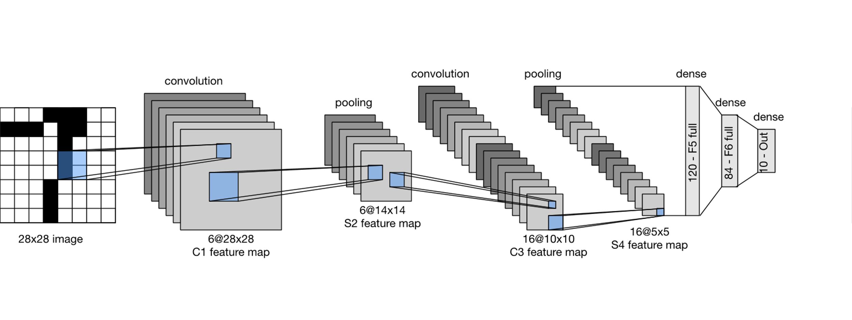
LeNet for hand writing recognition
LeNet (LeNet-5) consists of two parts:
a convolutional encoder consisting of two convolutional layers; and
a dense block consisting of three fully-connected layers
The basic units in each convolutional block are
a convolutional layer,
a sigmoid activation function, and
a subsequent average pooling operation.

Slide 18
LeNet for hand writing recognition
ReLUs and max-pooling work better (later discoveries)
Each convolutional layer uses a 5×5 kernel and
A sigmoid activation function.
The first convolutional layer has 6 output channels and the second has 16.
Each 2×2 pooling operation (stride 2) reduces dimensionality by a factor of 4 via spatial downsampling.

Slide 19
Modern CNN architectures with ImageNet
The ImageNet Large Scale Visual Recognition Challenge (ILSVRC) evaluates algorithms for object detection and image classification at large scale.
14+ Million images with labels
http://www.image-net.org/challenges/LSVRC/

Slide 20
Modern CNN architectures with ImageNet
In this lecture
AlexNet
VGGNet
Other networks for your reading
Network in Network (NiN)
Networks with Parallel Concatenations (GoogLeNet)
Residual Networks (ResNet)
Recommended reading
‘Dive into Deep Learning’ Chapter 7

Slide 21
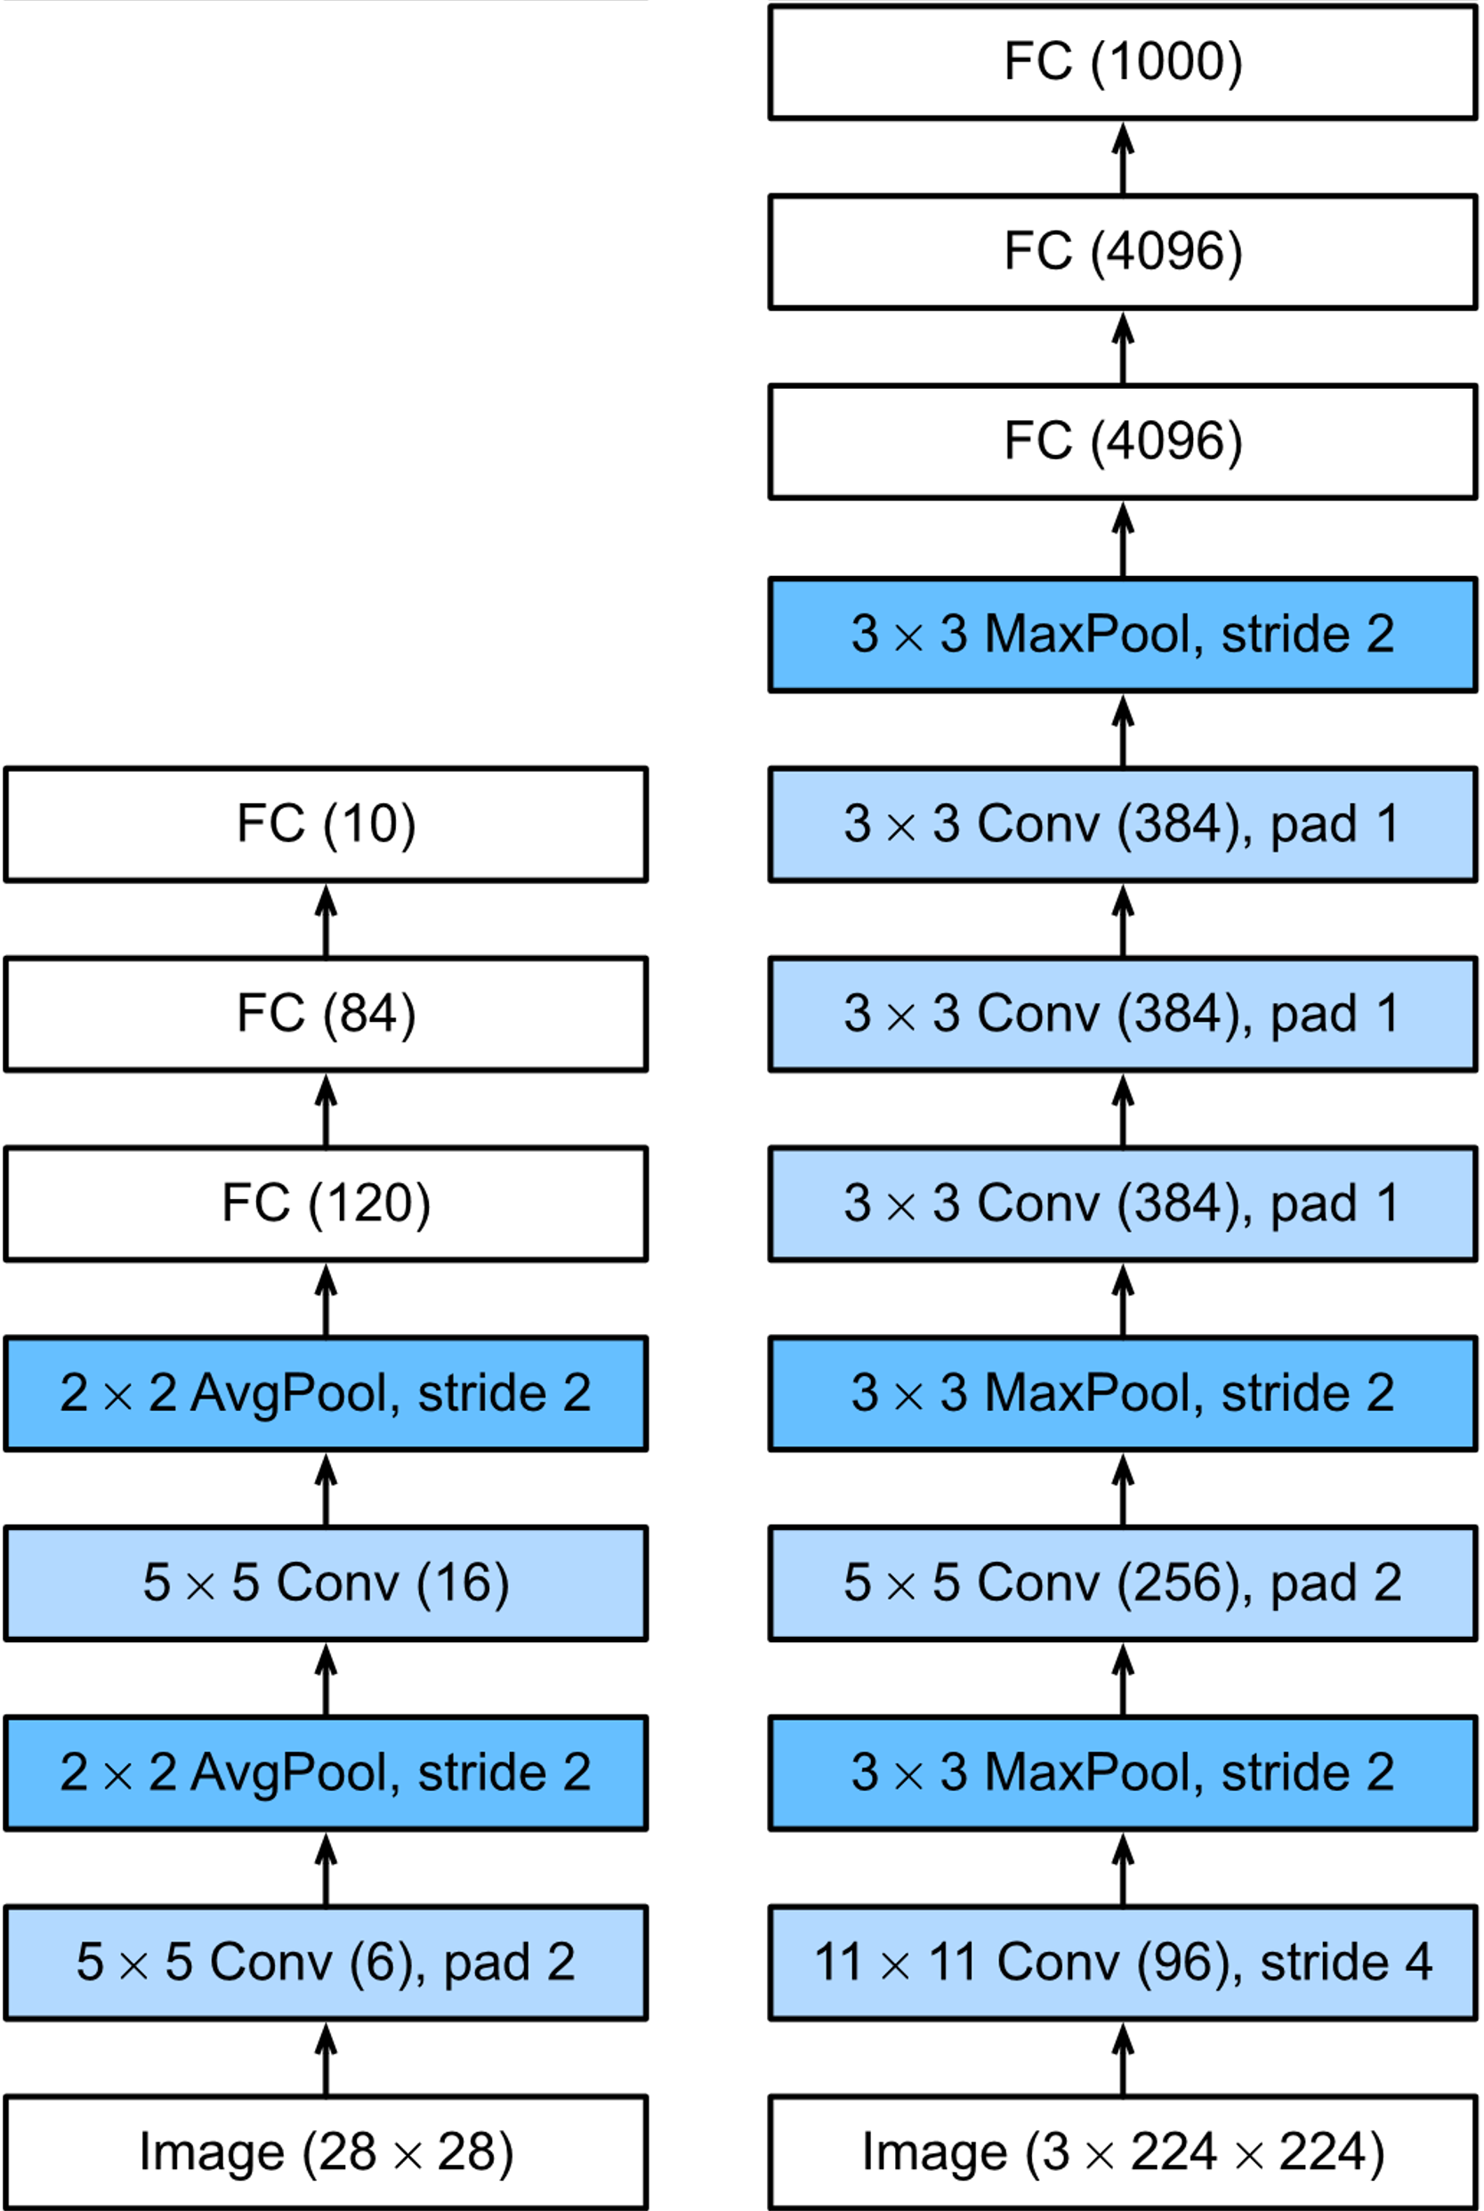
AlexNet

Slide 22
AlexNet
First layer: the convolution window shape is 11×11.
ImageNet images are more than ten times higher and wider than the MNIST images, objects in ImageNet data tend to occupy more pixels.
A larger convolution window is needed to capture the object.
Second layer: the convolution window shape is 5×5, followed by 3×3.

Slide 23
AlexNet
After the first, second, and fifth convolutional layers, the network adds maximum pooling layers with a window shape of 3×3 and a stride of 2.
AlexNet has ten times more convolution channels than LeNet.
Two fully-connected layers with 4096 outputs.
These two huge fully-connected layers produce model parameters of nearly 1 GB.

Slide 24
AlexNet – Activation Functions
AlexNet changed the sigmoid activation function to a simpler ReLU activation function.
The computation of the ReLU activation function is simpler.
The ReLU activation function makes model training easier when using different parameter initialization methods.

Slide 25
AlexNet – overall architecture

Slide 26
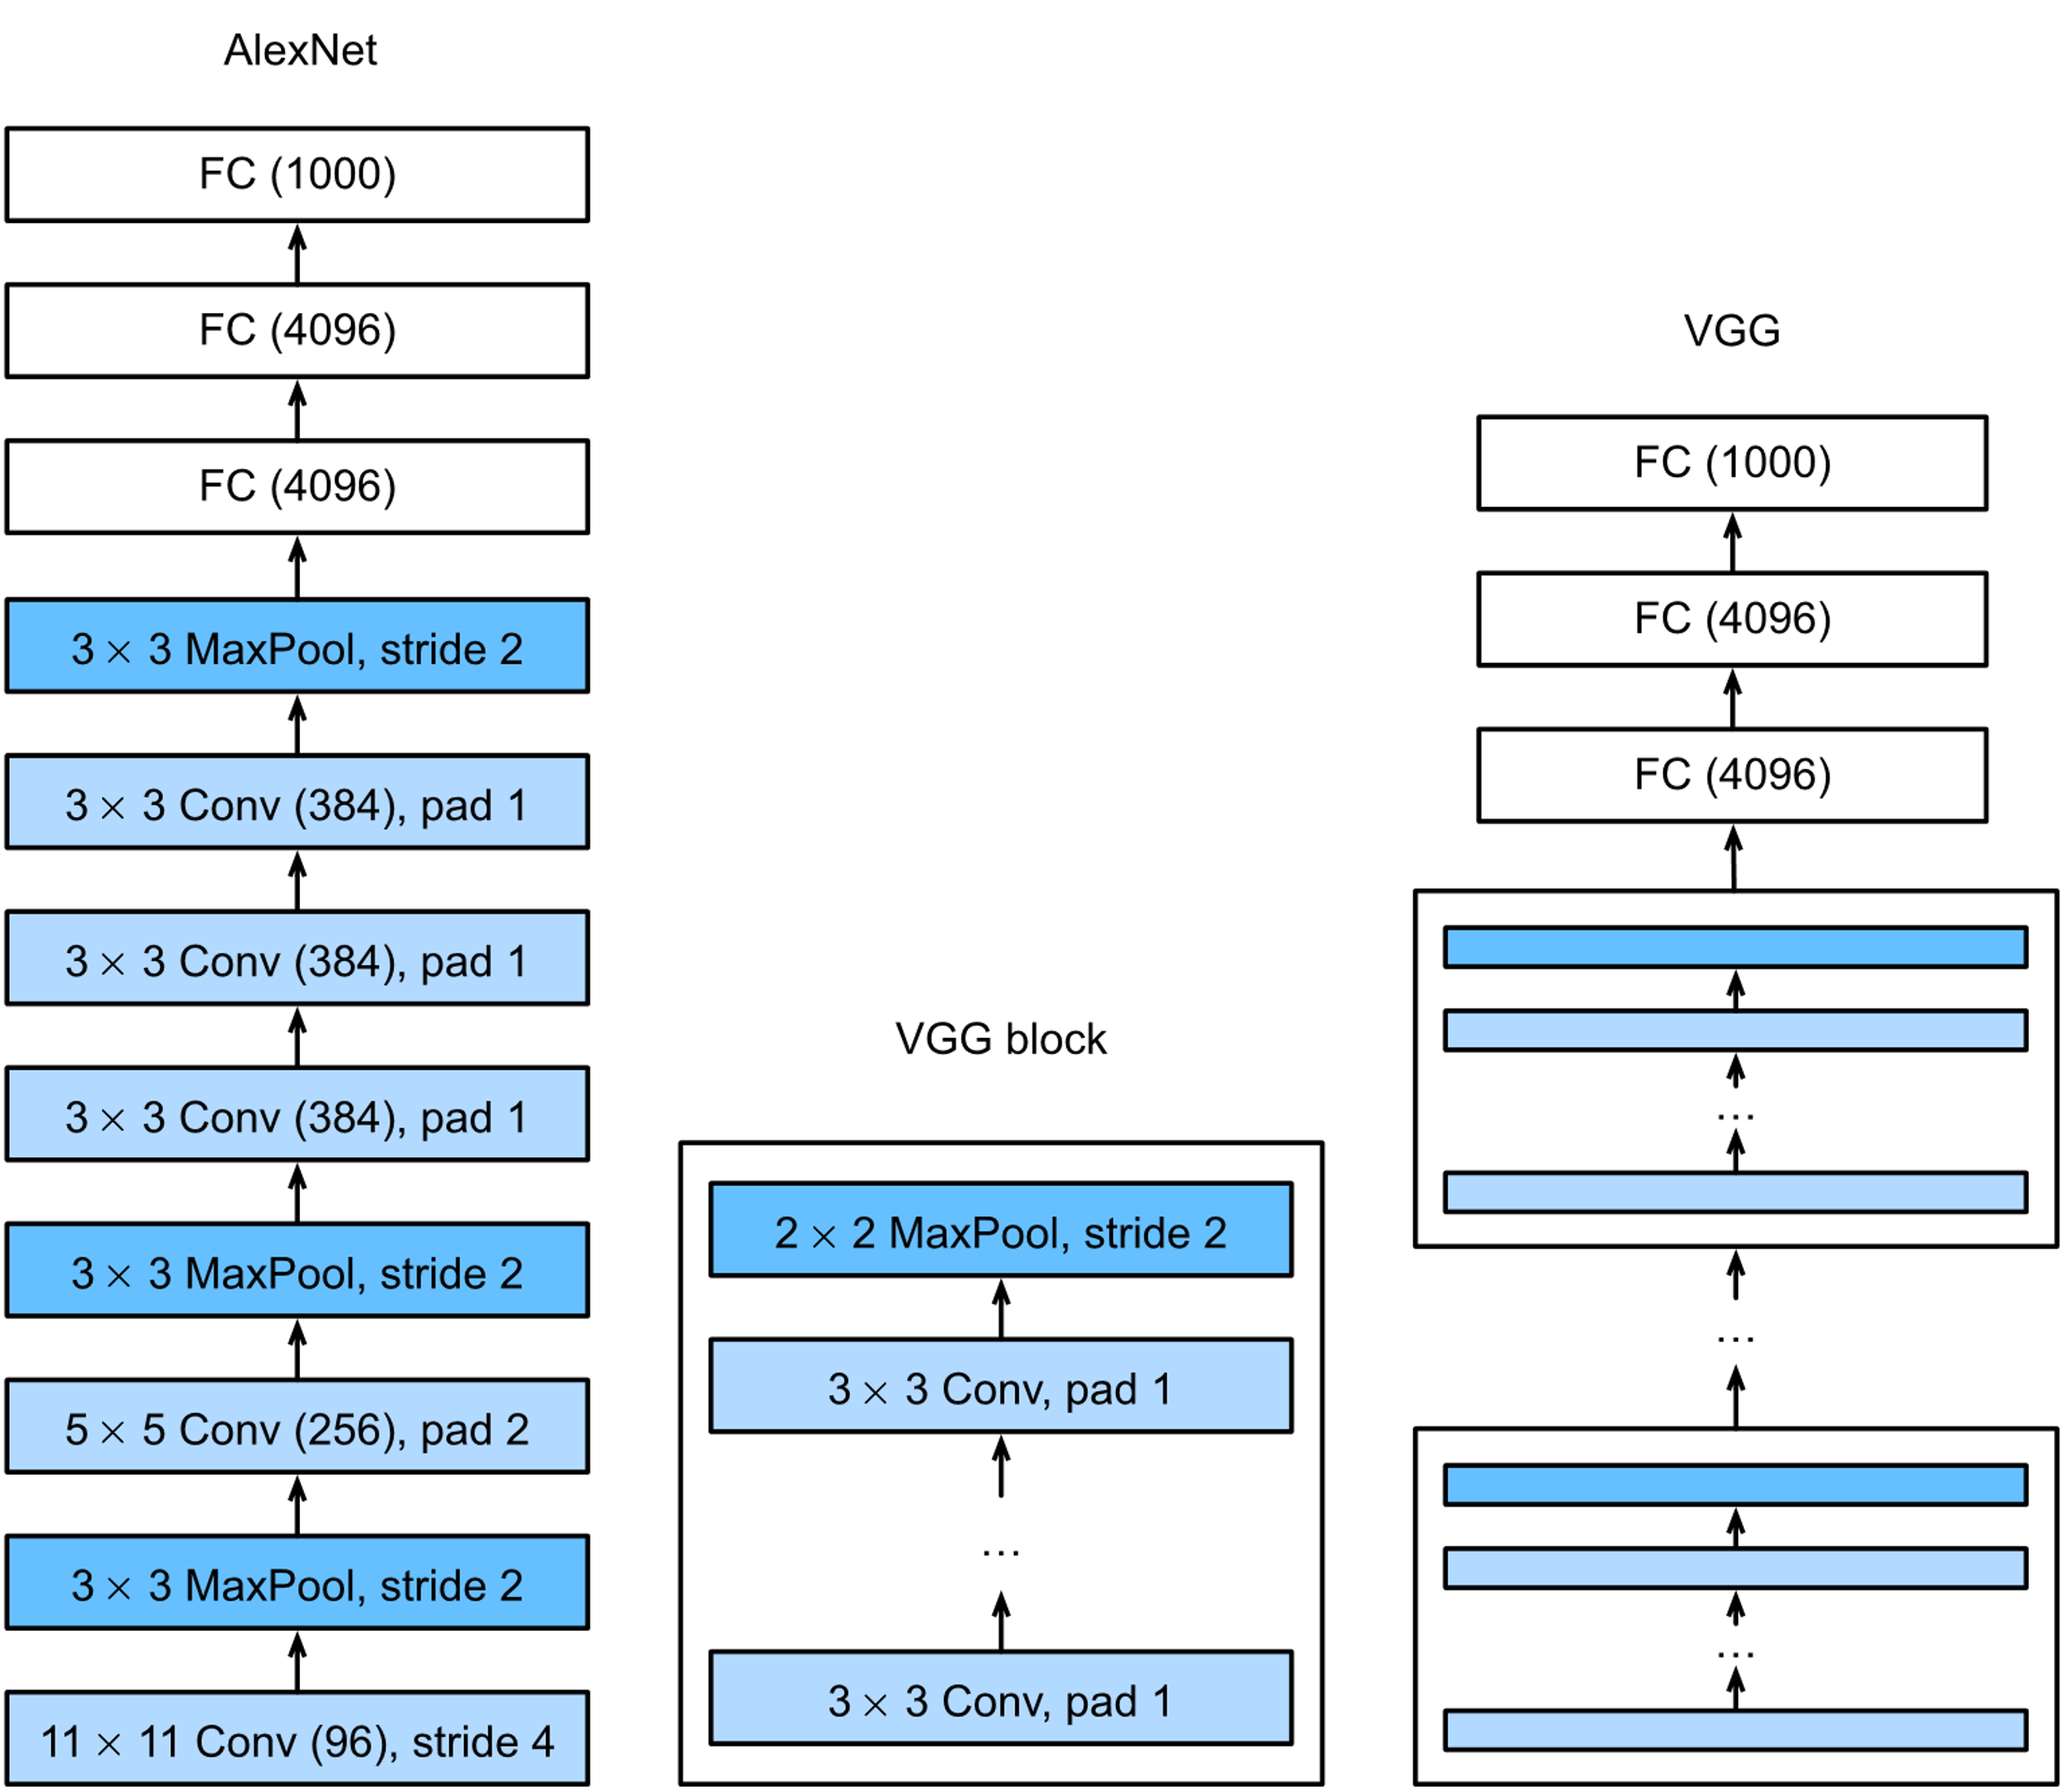
VGGNet

Slide 27
VGGNet
AlexNet is good but did not provide a general template.
The design of neural network architectures had grown progressively more abstract,
moving from thinking of individual neurons to whole layers, and now to blocks, repeating patterns of layers.
The idea of using blocks first emerged from the Visual Geometry Group (VGG) at Oxford University,
hence VGG network. Or VGGNet.
Now it is easy to implement these repeated structures in code with any modern deep learning framework by using loops and subroutines.

Slide 28
VGGNet block
The basic building block of classic CNNs is a sequence of the following: (i) a convolutional layer with padding to maintain the resolution, (ii) a nonlinearity such as a ReLU, (iii) a pooling layer such as a max pooling layer.
One VGG block consists of a sequence of convolutional layers, followed by a max pooling layer for spatial downsampling.
In the original VGG paper [Simonyan & Zisserman, 2014]:
convolutions with 3×3 kernels with padding of 1 (keeping height and width)
2×2 max pooling with stride of 2 (halving the resolution after each block).

Slide 29
VGGNet

Slide 30
VGGNet
Kernel size is 3x3 throughout
Total parameters in non FC layers = ~ 16M
Total Parameters in FC layers = (512 x 7 x 7 x 4096) + (4096 x 4096) + (4096 x 1024) = ~ 122M
Most parameters are in the first FC layer (~ 102M)

